Slide 1
My Homeland
Kishoregang Distric Of Dhaka Division

Slide 2
About Kishoreganj
Kishoreganj District (DHAKA division) with an area of 2688.59 sq km, is bounded by NETROKONA and MYMENSINGH districts on the north, NARSINGDI district on the southwest and BRAHMANBARIA district on the southeast, SUNAMGANJ and HABIGANJ districts on the east, GAZIPUR and Mymensingh districts on the west.

Slide 3
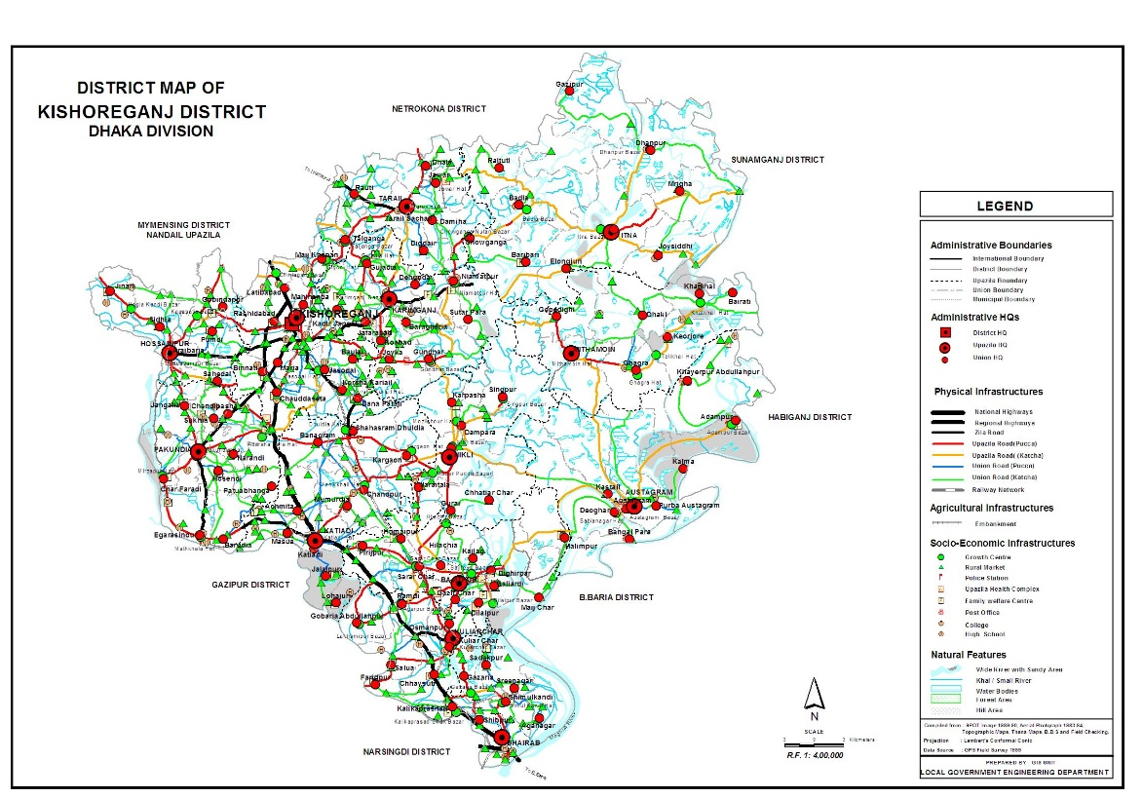
Map

Slide 4
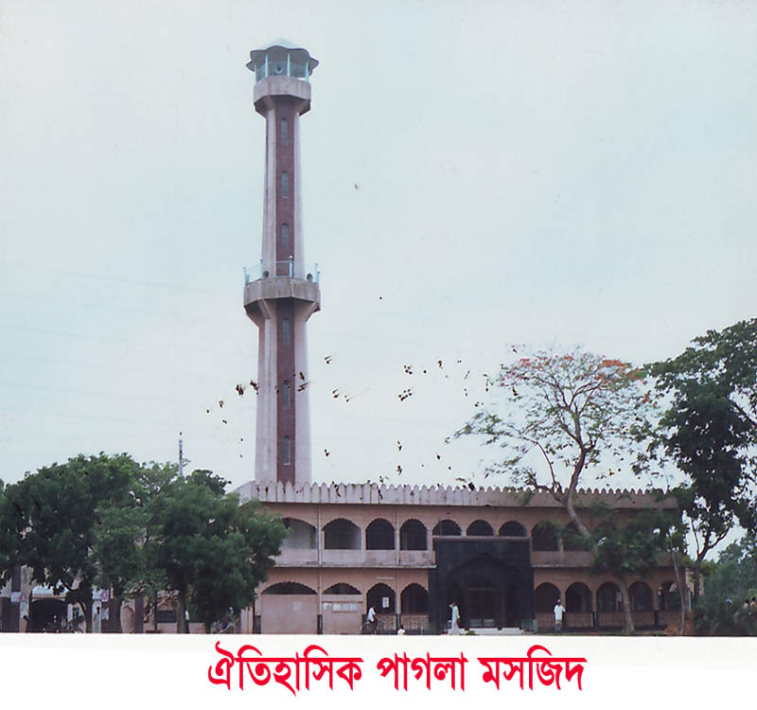
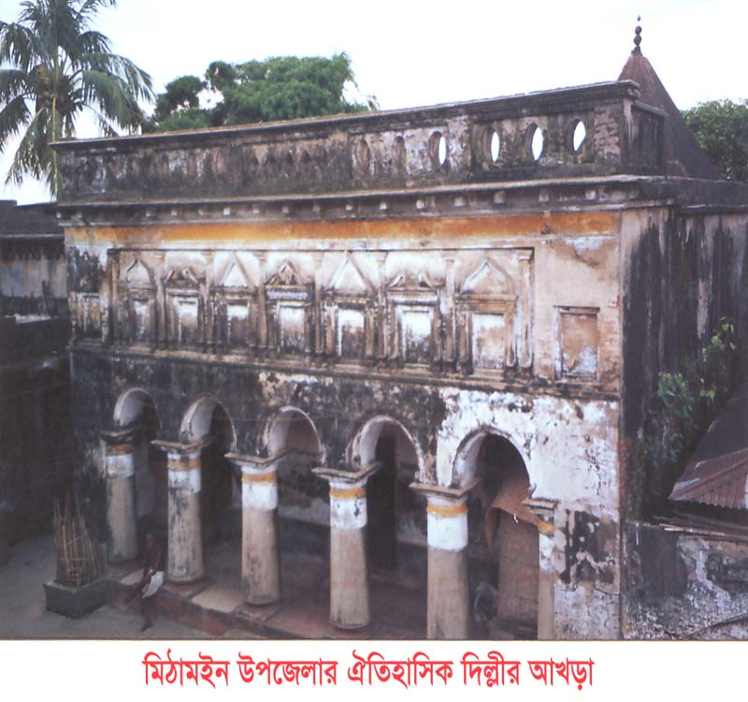
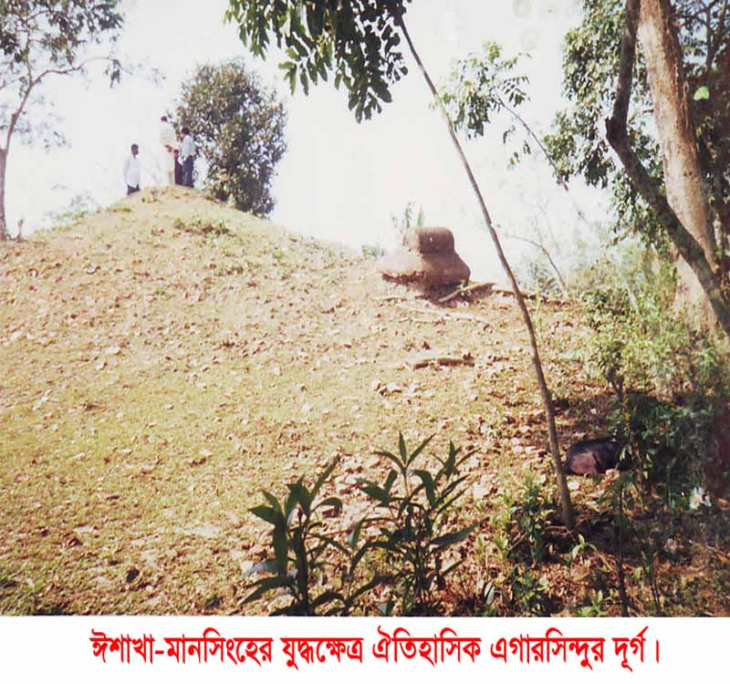
Historical Place

Slide 5
Thank You!!
For More Details About Kishoregang District Click Here https://oldweb.lged.gov.bd/DistrictLGED.aspx?DistrictID=19

